Slide 1
Adding a Little Style
Cascading Style Sheets

Slide 2
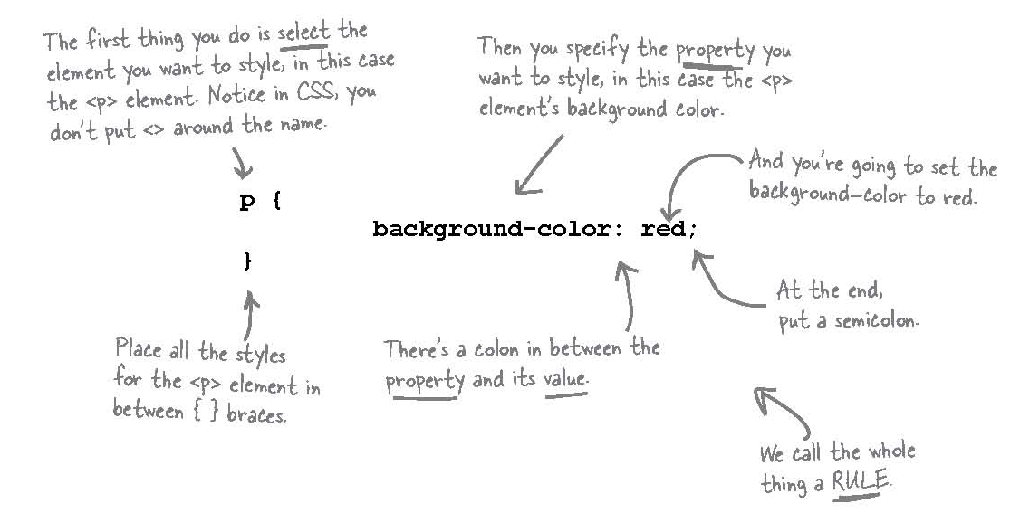
Cascading Style Sheets
The abbreviation is CSS and we have used them before briefly to modify our Starbuzz Page.

Slide 3

Add Some Style
We can also write the previous code as:
As it looks more compact.
What do you think the above rule does?
Sets the background colour to red for all paragraphs.

Slide 4
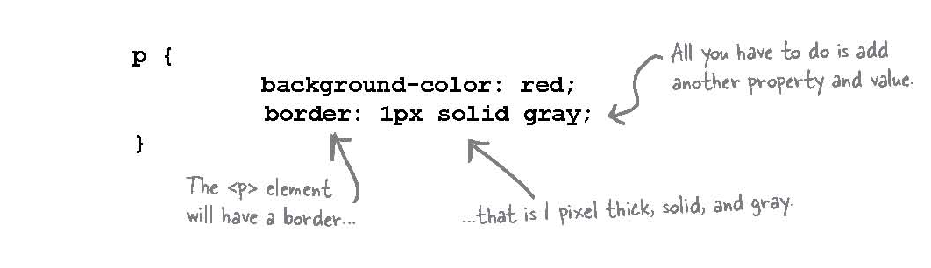
Wanna add more style?
You can add as many properties as you like to each CSS rule. Say you want to put a border around your paragraphs, too:

Slide 5
Question
Does every <p> element have the same style? Or can I, say, make two paragraphs different colours?

Slide 6
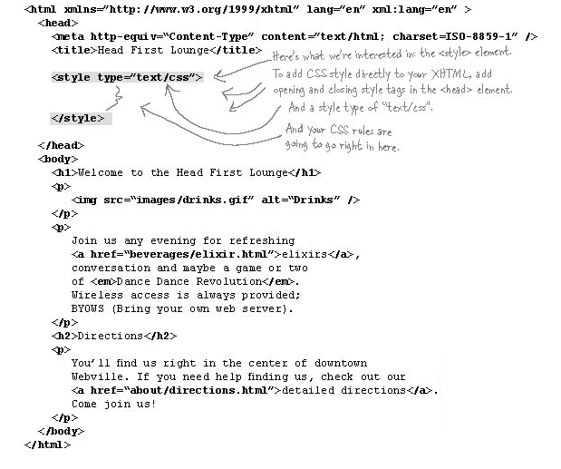
Getting CSS into your HTML

Slide 7
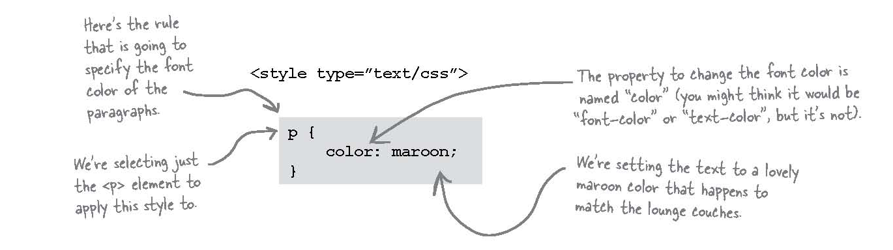
Adding style to the lounge
Let’s see what the Lounge looks like with some style:

Slide 8
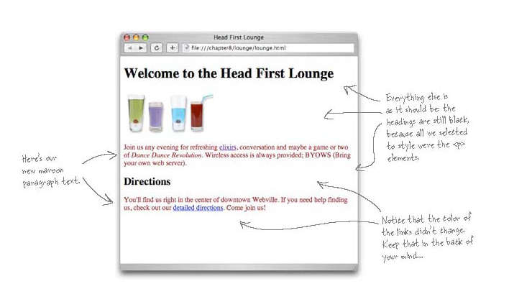
Adding Style to the Lounge

Slide 9
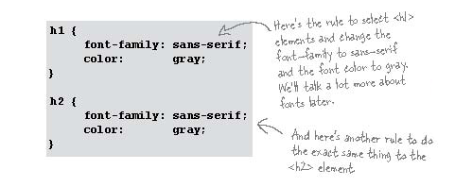
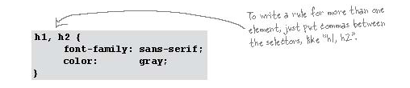
Style the heading
Or we could combine the rules as follows:

Slide 10
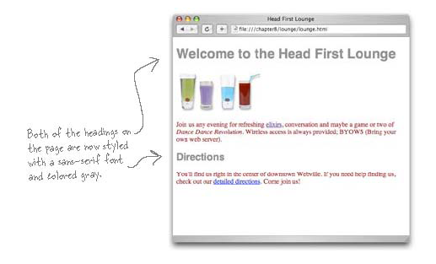
Head First Lounge with some style

Slide 11
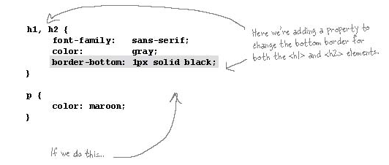
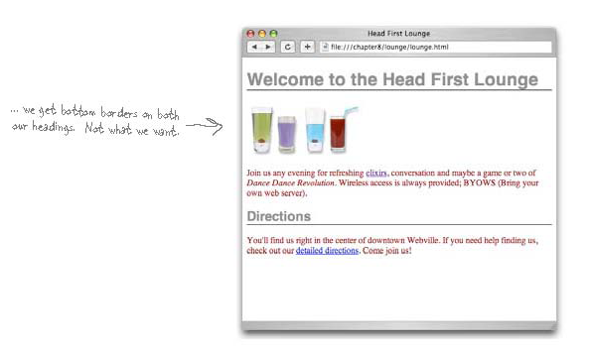
How about a line under the welcome message

Slide 12
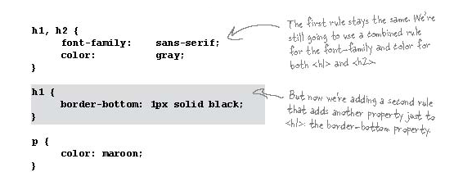
How do we remove the second border?

Slide 13
Question
How does it work when you have more than one rule for an element?
Answer:
You can have as many rules as you want for an element. Each rule adds to the style information of the rule before it.
In general, you should try and group together all the common styles between elements like we did with <h1> and <h2>.

Slide 14
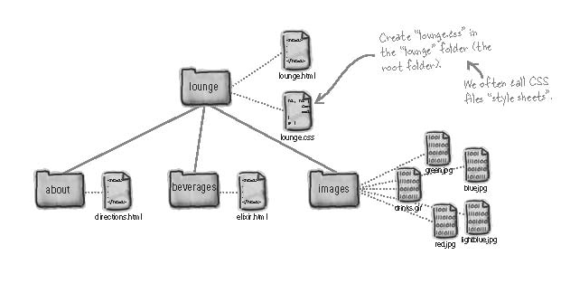
Sharing a little CSS
Let’s look at the Directory Structure Again:

Slide 15
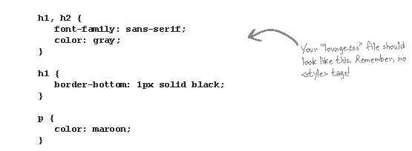
Create lounge.css
We are going to create a single lounge.css style sheet and have all of our pages refer to it so that they all look the same.
In louge.css add the following:

Slide 16
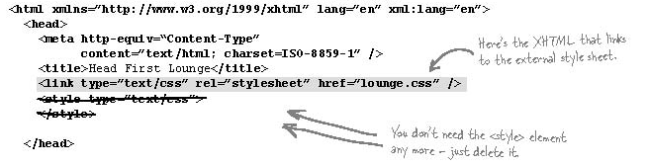
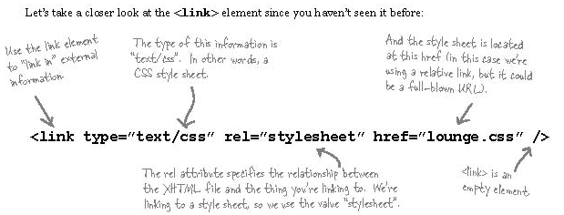
Remove the <style> from lounge.html

Slide 17
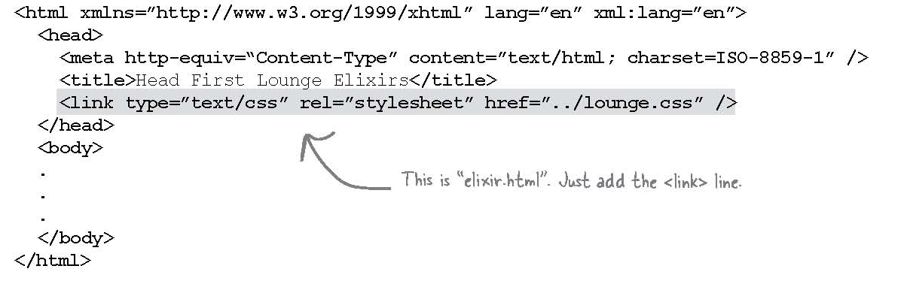
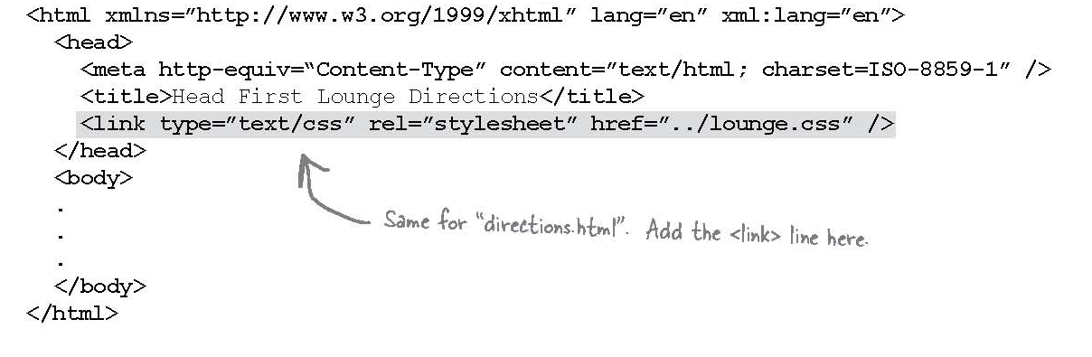
Let’s give “elixir.html” and “directios.html” some style.

Slide 18
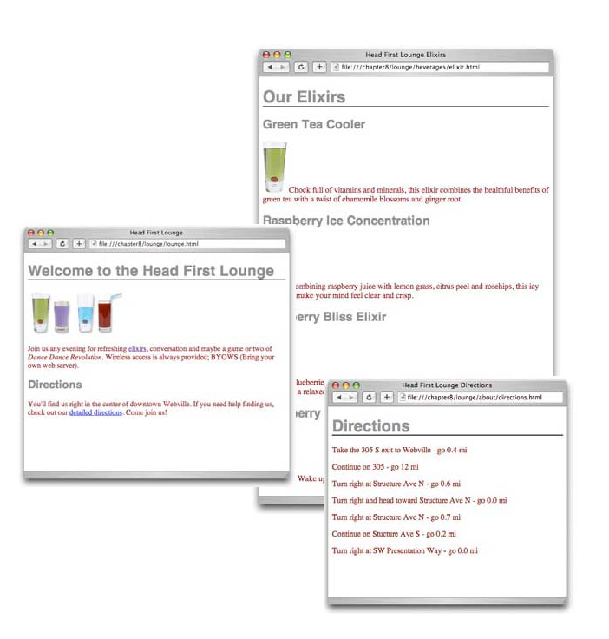
So what does it look like?

Slide 19
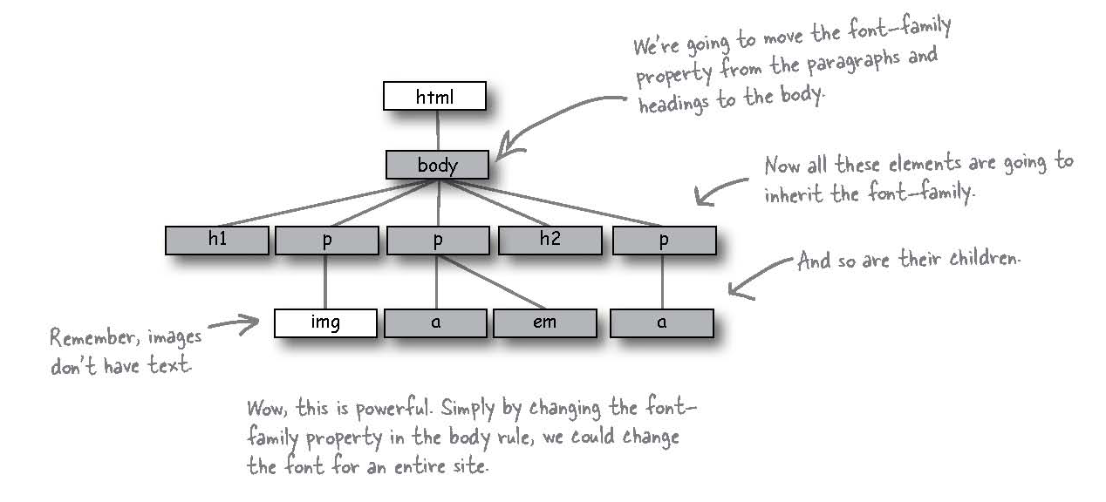
Inheritace in css

Slide 20
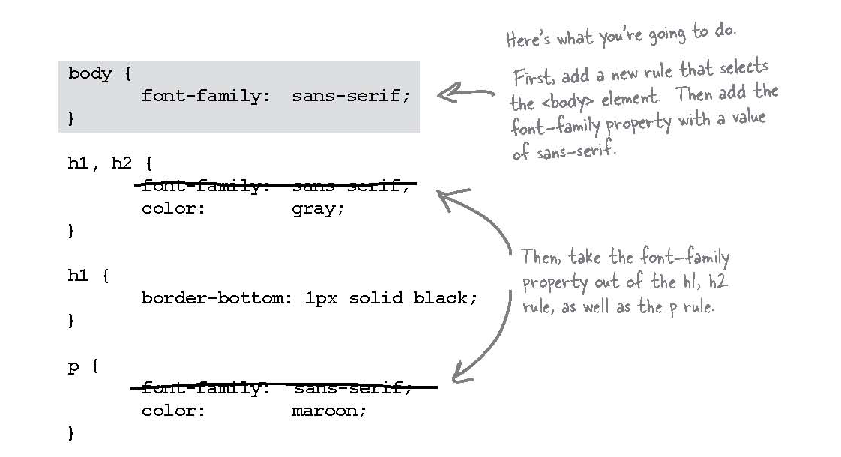
Using Inheritance
Make the change in you CSS style sheet.

Slide 21
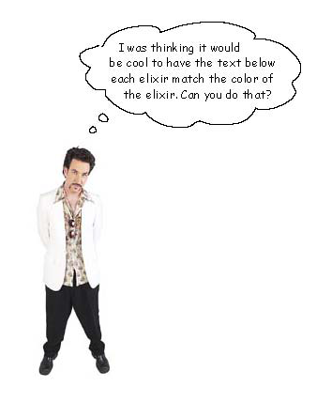
Now what if we want to get really fancy?

Slide 22
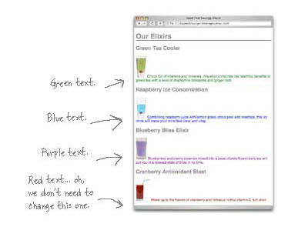
Meh .. It’s Different!

Slide 23
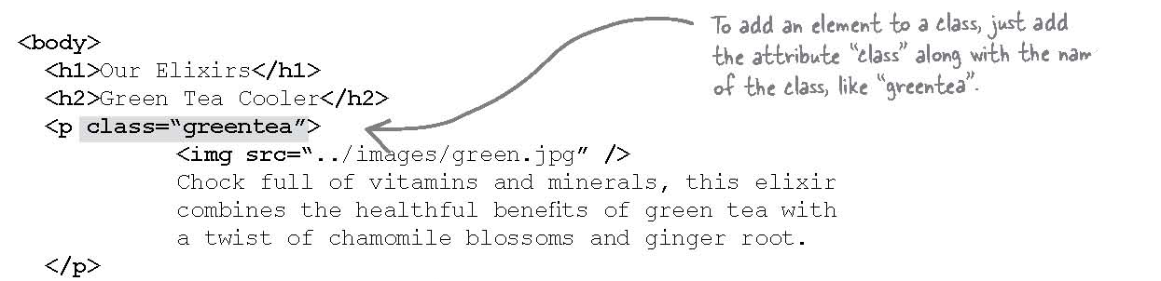
We need to add a class to the paragraph tag.
Add appropriate tags to the rest of paragraphs that will match what the client wanted.

Slide 24
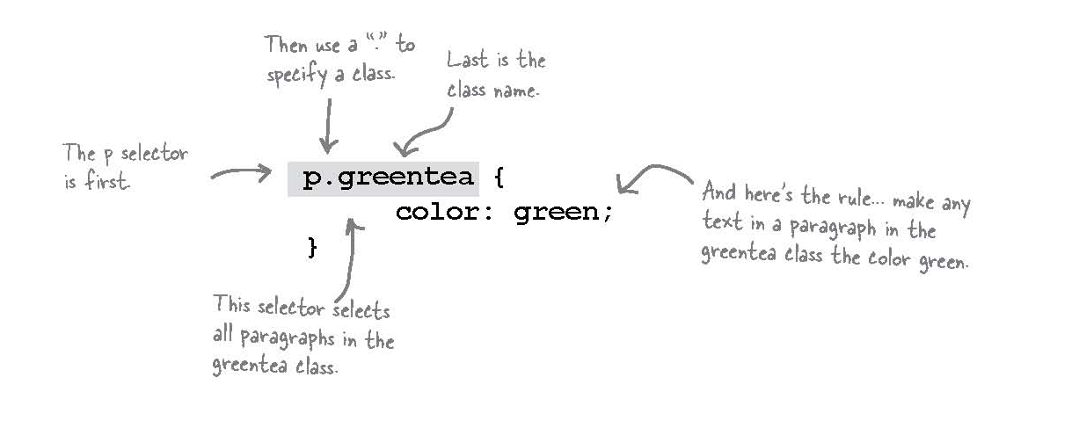
Creating a Selector for the class

Slide 25
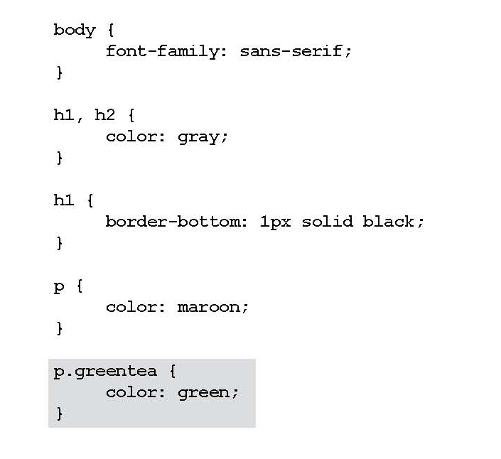
Modifying the Style Sheet

Slide 26
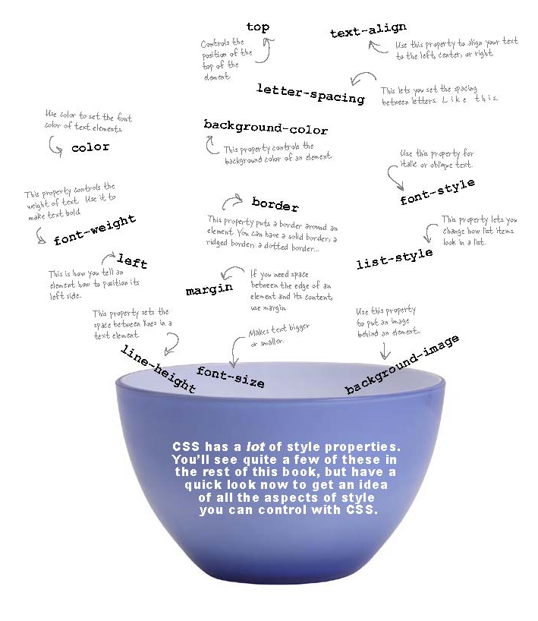
Property Soup

Slide 27
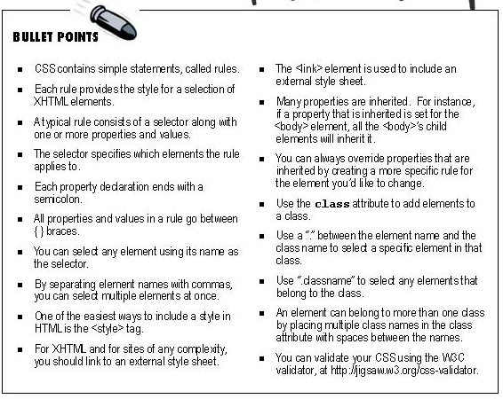

Slide 28
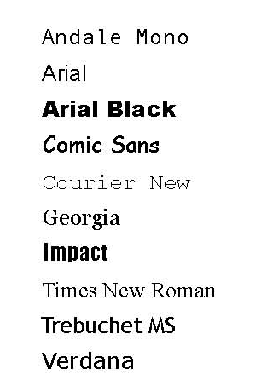
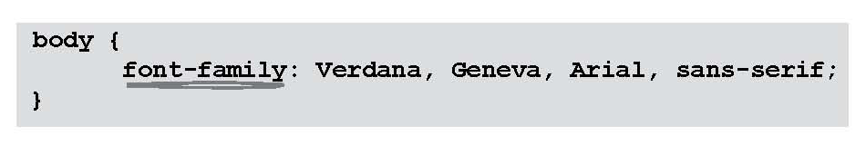
Summary of CSS Properties - Font Family

Slide 29
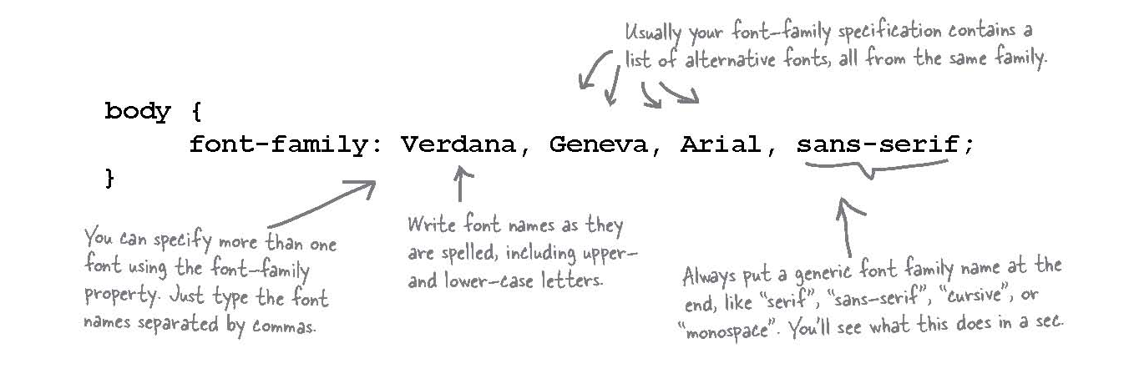
Font-Family

Slide 30
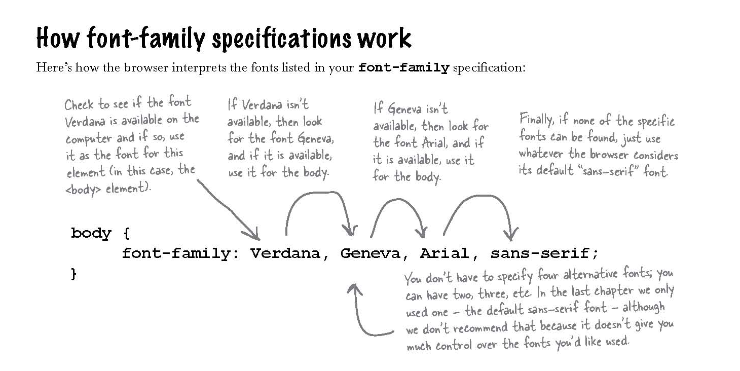
Font Family

Slide 31
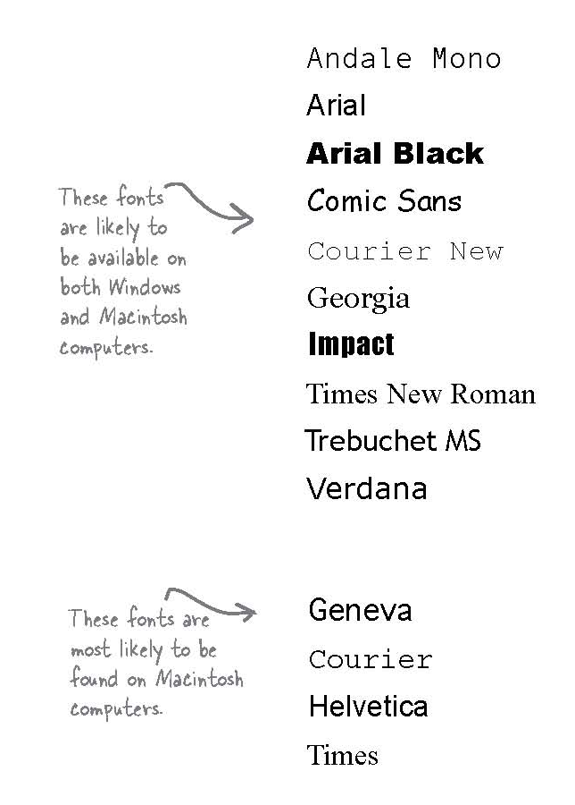
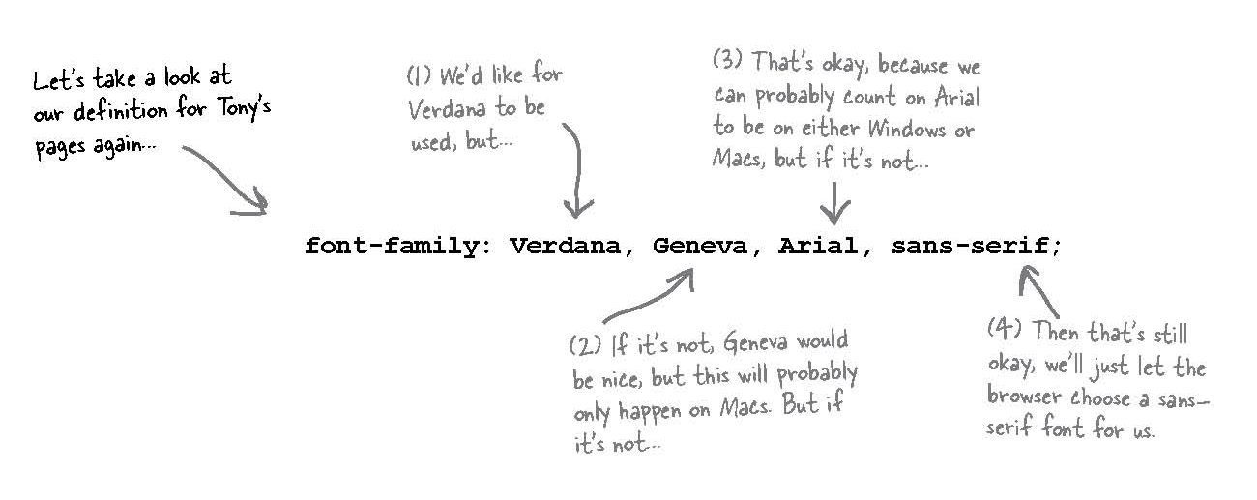
Font Family

Slide 32
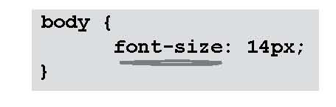
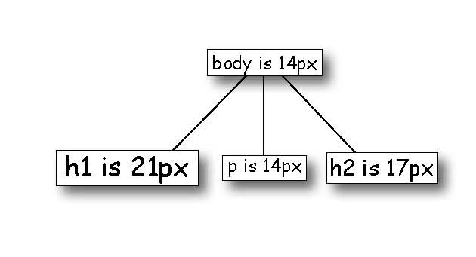
Change the Font Size

Slide 33
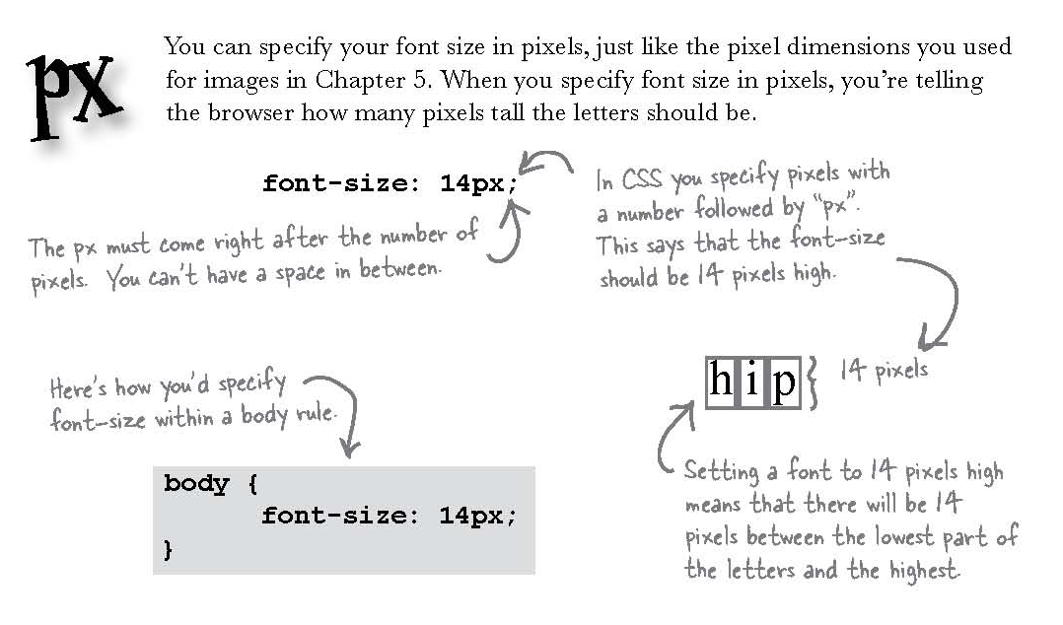
Adjusting font sizes

Slide 34
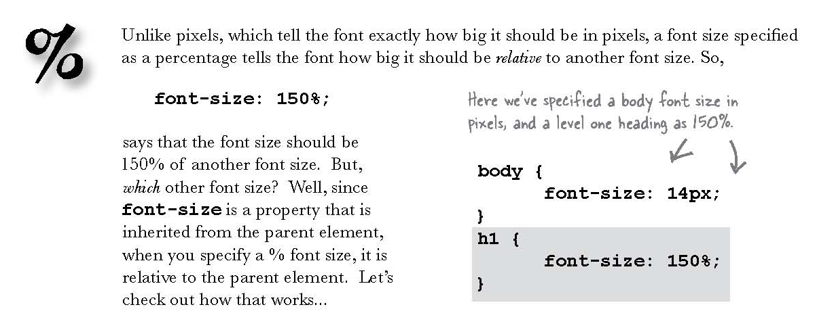
Adjusting font sizes

Slide 35
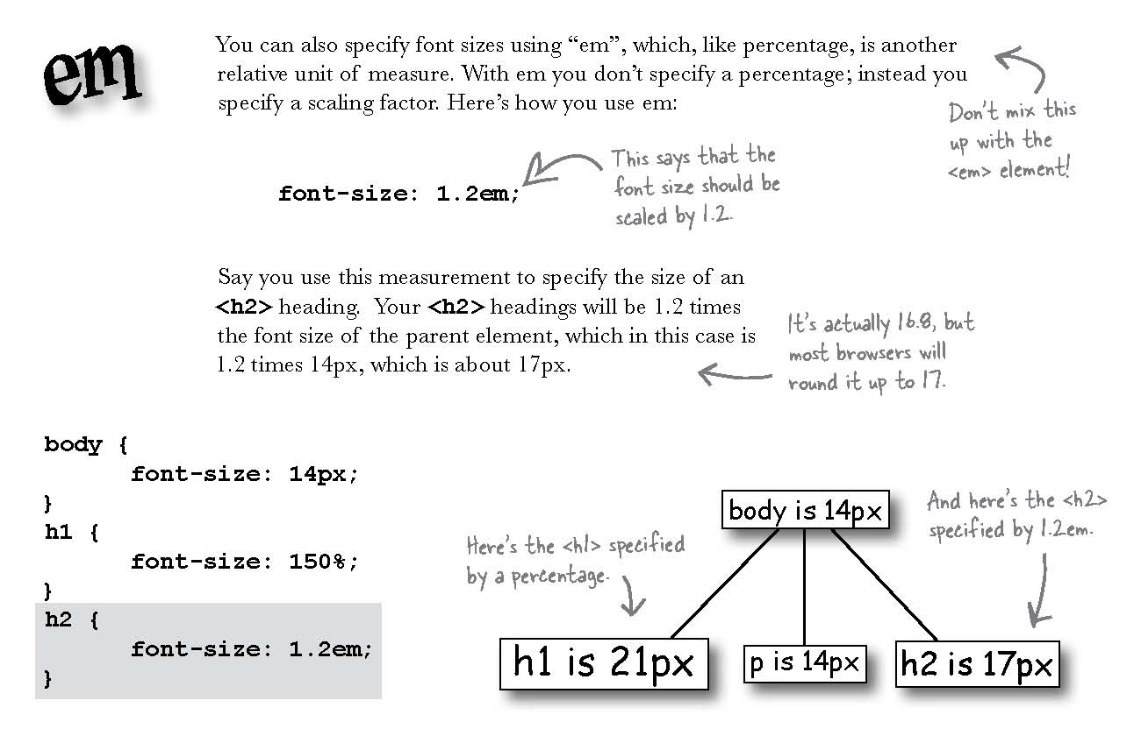
Adjusting font sizes

Slide 36
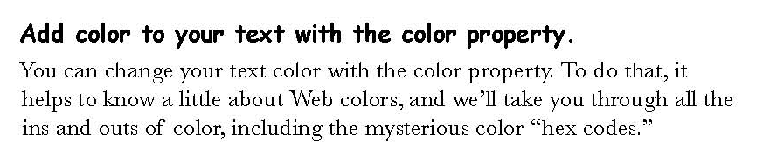
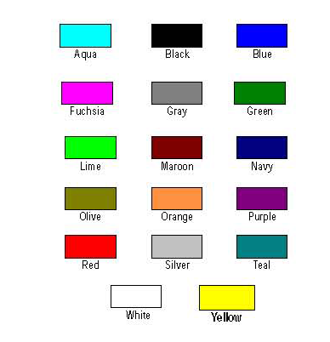

Font Color

Slide 37
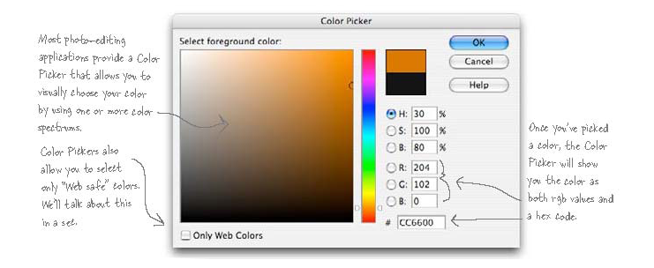
Color Picker

Slide 38
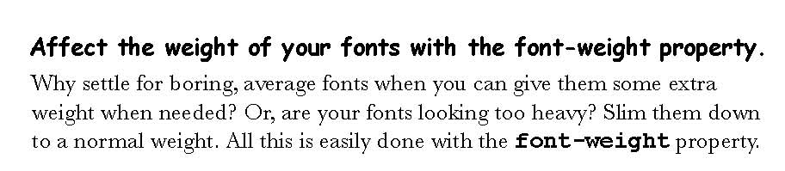


Font Weight

Slide 39
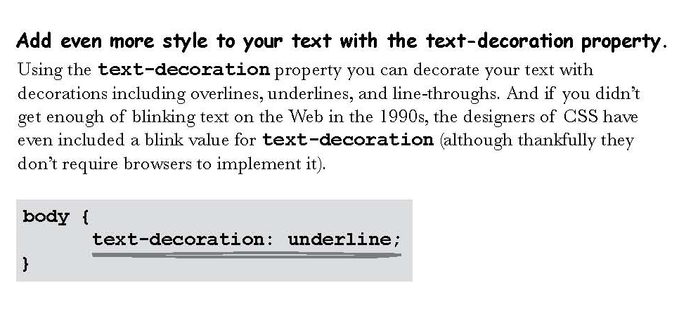
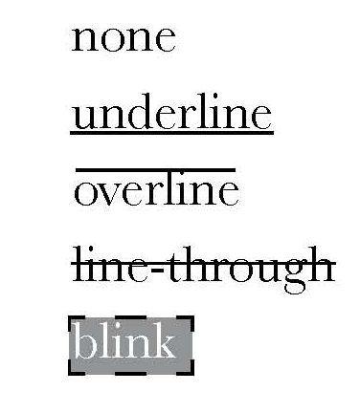
Text Decoration

Slide 40
